Slide 1
NextGen Airfoil
Computational Design for enhanced Lift-to-Drag Ratio
DP2 – AIRFOIL SHAPE OPTIMIZATION
Srima Santosh Revankar – 1RV24AS052
Rishit Kumar – 1RV24AS042
Shreyas Deshmukh – 1RV24AS047
Sai Arvind Akella – 1RV24AS045

Slide 2
Problem Understanding + Planning & Approach + Implementation Details
Problem understanding:
Airfoil geometry strongly affects lift, drag, pressure distribution and flow separation. The challenge is to improve aerodynamic efficiency (L/D) under specified operating conditions while maintaining structural feasibility (t/c ≥ 10%).
Planning and Approach:
Screened multiple airfoils from the UIUC database.
Evaluated aerodynamic performance using XFLR5.
Selected Eppler 423 (E423) as the baseline airfoil based on superior L/D performance.
Identified key geometric parameters affecting aerodynamic efficiency: thickness, thickness position, and camber.
Reduced thickness to lower drag.
Shifted maximum thickness forward for better pressure recovery.
Increased camber slightly to maintain lift.
Generated multiple design iterations in XFLR5.
Compared Cl, Cd, L/D, and stall characteristics.
Rejected high-L/D designs with poor stall behavior.
Selected the best balance of performance and stability.
Maintained t/c = 10.03% to satisfy structural feasibility requirements.
Compared baseline and optimized configurations.
Validated the final design using CFD simulations.

Slide 3
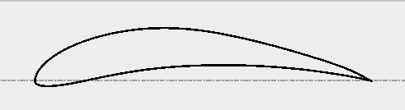
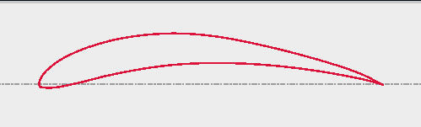
Innovativeness of the Solution + Design Rationale
Why E423?
Highest L/D among tested airfoils
Strong low-Reynolds-number performance
Satisfies thickness requirements
Good potential for further optimization
Innovativeness of Solution: Instead of maximizing L/D alone, a constraint-driven and performance-balanced optimization approach was adopted.
Geometry Changes:
Final Airfoil Coordinates here =>
Parameter | Baseline | Optimized | Reason
Thickness | 12.52% | 10.03% | Reduced Drag
Max Thickness Position | 26.13% | 23.72% | Improve pressure recovery
Max Camber | 10.05% | 10.50% | Maintain lift
Max Camber Position | 44.04% | 44.04% | Retained for stability
E423
Optimized E423

Slide 4
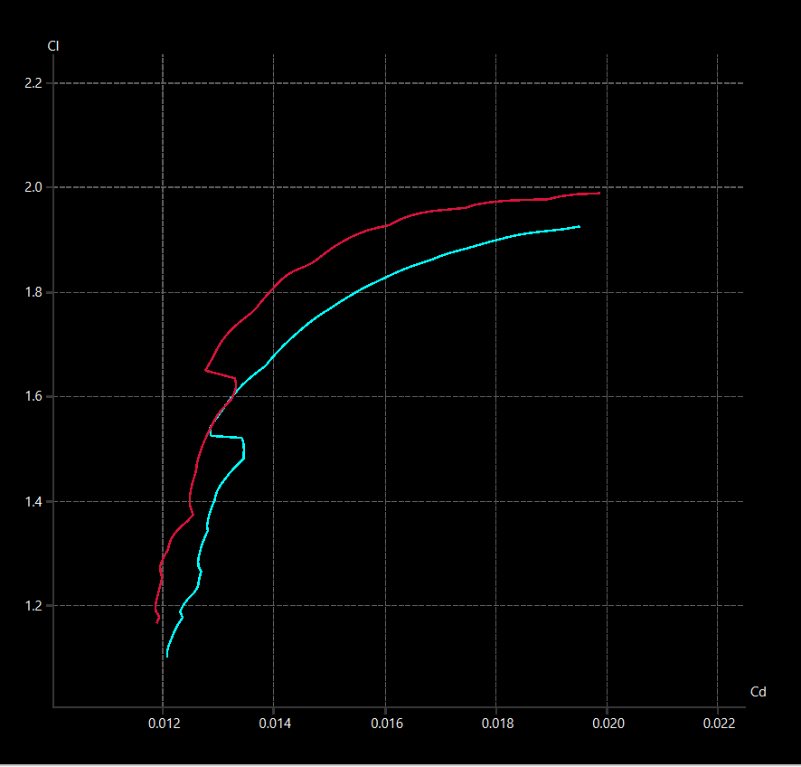
Results + Performance Comparison
E423
Baseline airfoil name = E423
Design Condns. : Re = 500k, M=0.1
for AoA = 0° to 10°
Peak L/D= 130.740 at AoA= 5.5°
Max thickness-to-chord ratio (t/c%)= 10.03%
% Improvement over baseline= 7.62%
Tools & Software Used:
XFLR5
Ansys CFD
Solidworks
*ClvsAoA and CdvsAoa plots included in next slide
Modified
E423
Parameter | E423 | Optimized
Cl @ 5° | 1.59003 | 1.67559
Cd @ 5° | 0.01317 | 0.01289
L/D @ 5° | 120.743 | 129.944
Cl vs Cd comparison
The modified airfoil polar sits above and to the left of the baseline E423, confirming a superior lift-to-drag ratio across the operating range. The modified airfoil reaches higher Cl values at equivalent or lower Cd, making it the aerodynamically more efficient choice - particularly relevant around the Cl ≈ 1.6–1.8 cruise region.

Slide 5
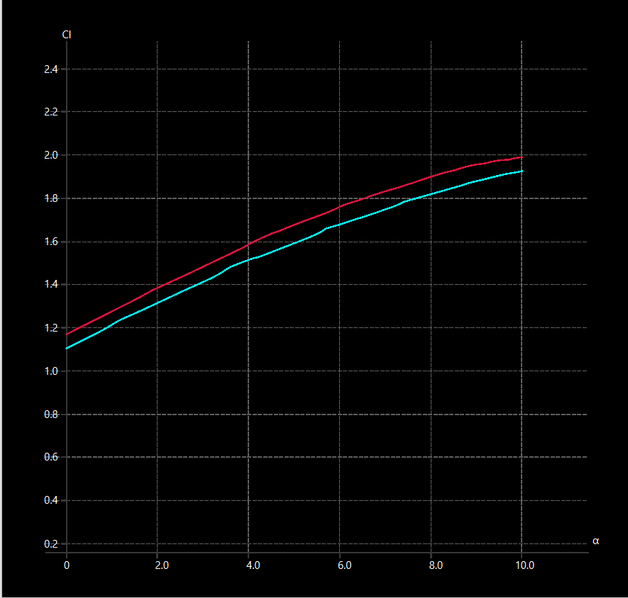
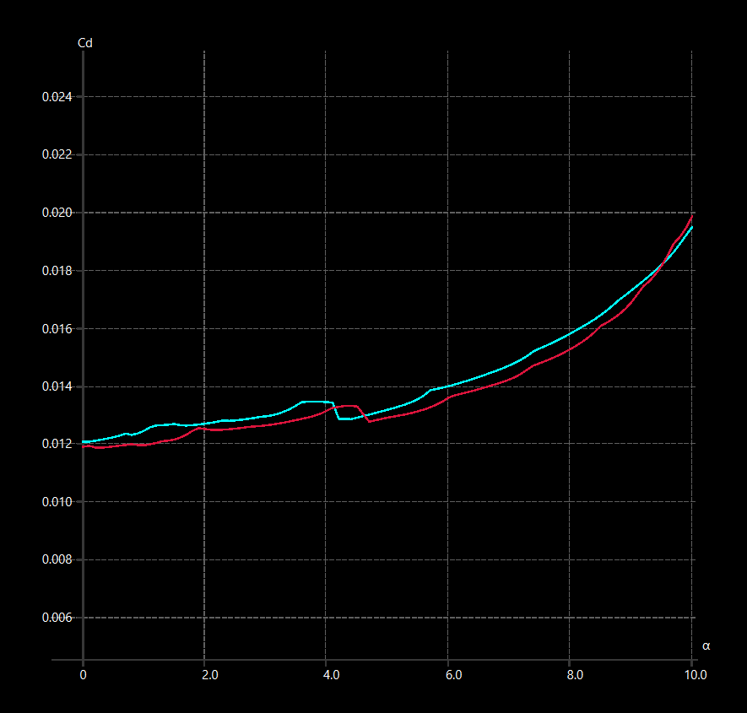
Cl & Cd vs AoA plots
E423
Modified
E423
Cl vs AoA comparison
Cd vs AoA comparison
The modified airfoil consistently generates higher lift than E423 at every angle of attack, with the gap widening beyond 4°. The modified profile achieves a Cl of ~2.0 near 10°, outperforming the baseline by approximately 0.05–0.08, indicating improved camber effectiveness or boundary layer behavior.
The modified airfoil maintains lower drag than the baseline E423 across mid-range angles (4°–9°), suggesting the modification reduces pressure drag in the operationally relevant AoA range. Both airfoils show comparable drag at low AoA (0°–2°), with divergence becoming more pronounced beyond 5°.

Slide 6
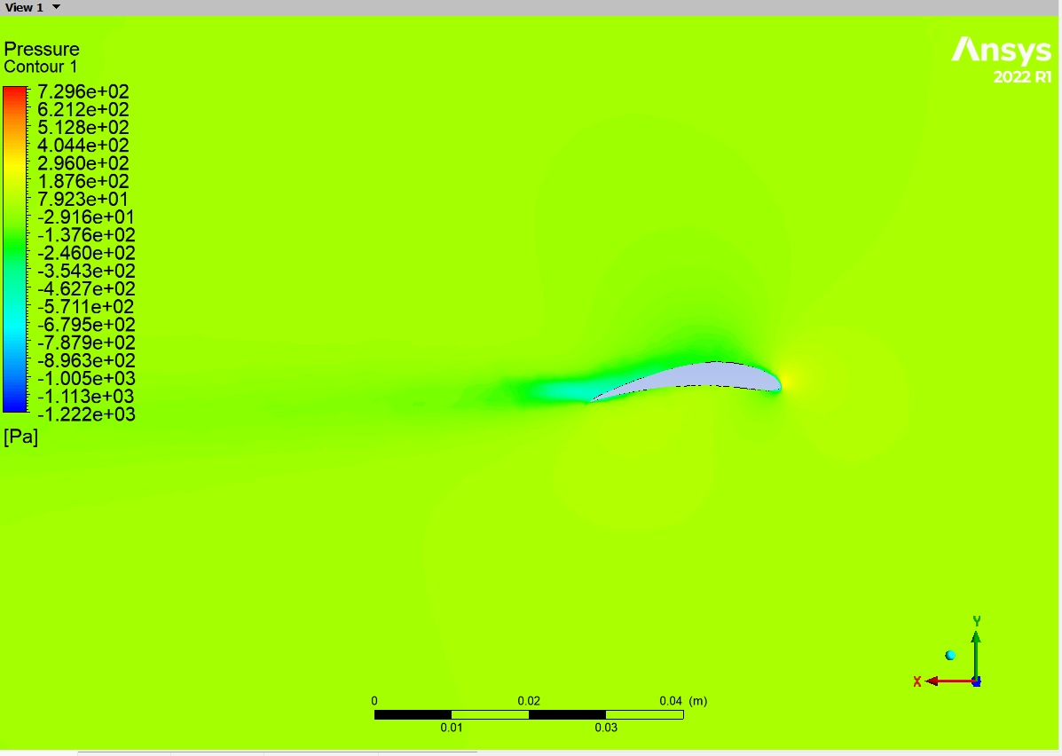
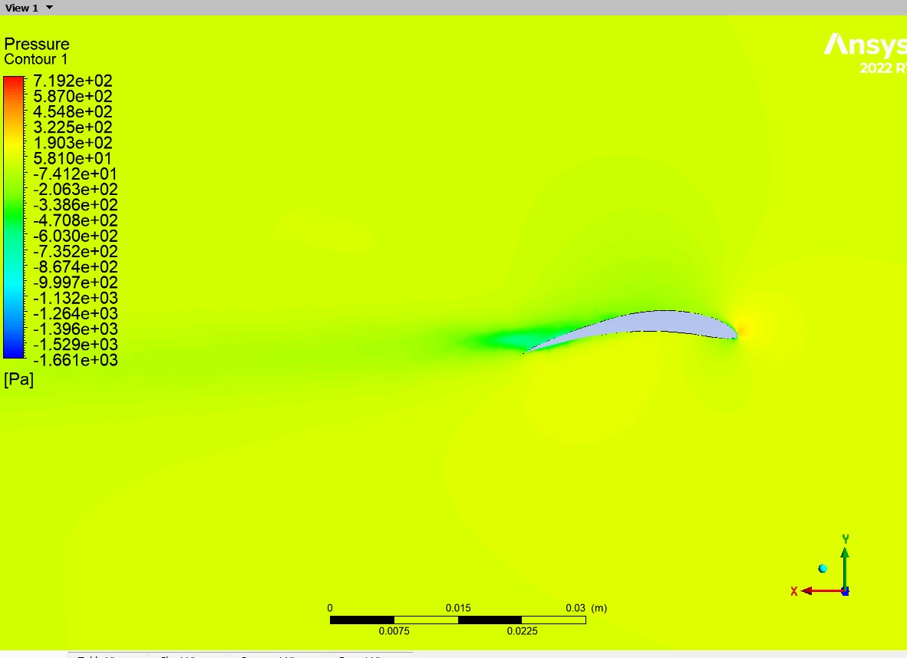
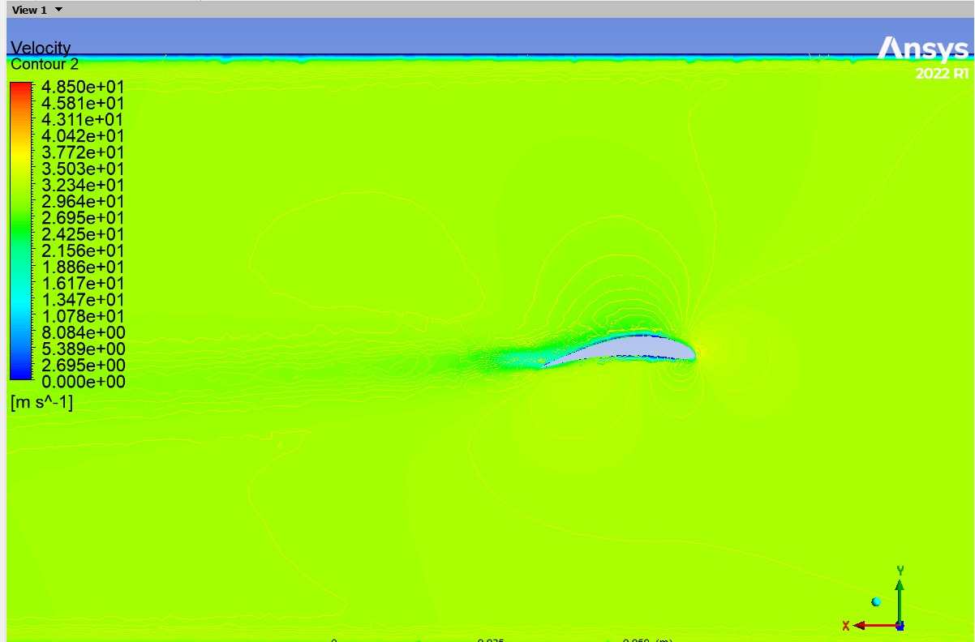
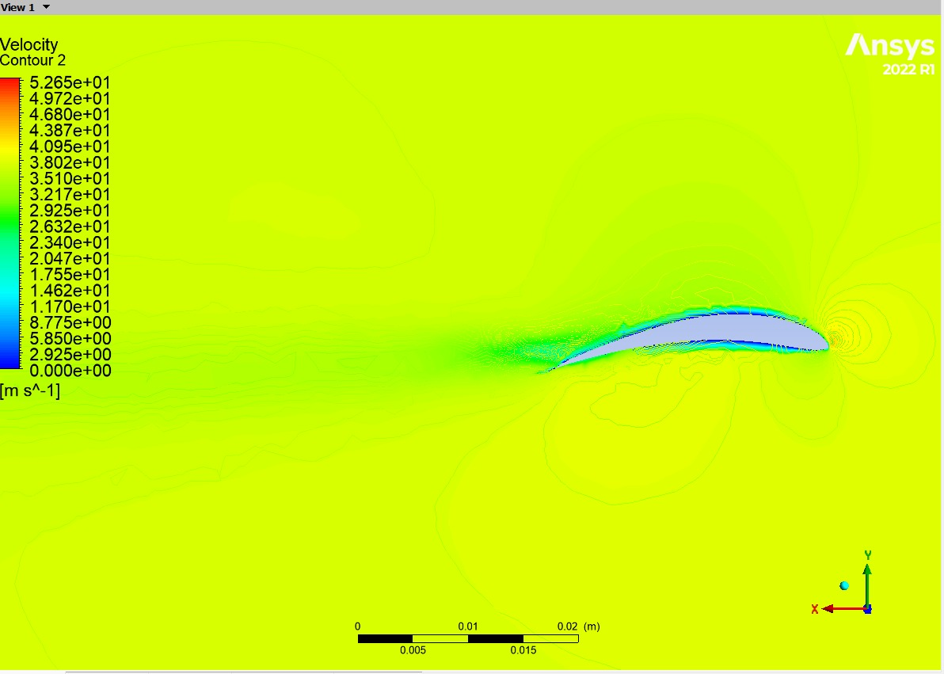
CFD Validation & Flow Visualization
A 3D CFD study was performed in ANSYS Fluent to capture finite-span effects and more realistic flow behavior, providing a closer representation of practical operating conditions
CFD Results: The optimized E423 achieved a lift coefficient of 0.50 compared to 0.47 for the baseline airfoil, representing a 6.4% increase in lift.
Suction peak intensifies to ~−1,661 Pa (~36% stronger), with the low-pressure zone extending further along the chord - directly explaining the higher Cl in the modified design.
Suction peak of ~−1,222 Pa concentrated near the leading edge with gradual pressure recovery, indicating attached flow and moderate lift generation.
Pressure and Velocity Contours of Optimized E423
Peak velocity rises to ~52.65 m/s with accelerated flow extending further aft. Subtle trailing-edge recirculation hints at a boundary layer approaching its separation limit -a tradeoff for the lift gain.
Pressure and Velocity Contours of E423
Flow accelerates to ~48.5 m/s over the upper surface with a clean, minimal wake - confirming attached boundary layer at AoA = 5°.

